Slide 1
PixelSales
Videogame Statistical Analysis

Slide 2


01
OUR COMPANY

Slide 3
PIXELSALES
Our company was created by game experts who want other gamers to be able to easily find more games, while supporting the industry and promoting games to potential players.

Slide 4
PIXELSALES
Our goal is to collect and store information on video games sales to perform targeted advertisements for gaming companies. We provide gamers information about games and host a website with discussion boards and chat rooms where gamers can connect.

Slide 5
02
DATA GATHERING, CLEANING & IMPORTING

Slide 6
DATA GATHERING
PixelSales uses game data from Steam, Xbox, and Playstation.
We scrape user profiles, libraries, and achievements, as well as game statistics, costs, and reviews.
Data collected is numerical as well as categorical.

Slide 7
DATA USAGE AGREEMENT
Scraped data will be shared publicly
However, user profiles on our website remain private. By signing up, users consent to their data being collected and used for analysis, while ensuring their privacy is protected.

Slide 8
DATA CLEANING & IMPORTING
Data cleaning involves handling missing values, removing or correcting errors, and ensuring data consistency across datasets.
Python classes are used to create models for data mapping and importing to database.
ETL method was used: data is cleaned prior to uploading to MySQL.
Notes:
Consistency checks will be put into place to ensure data is being stored properly. All times should be in the user’s timezone. Data is cleaned after extraction and before being uploaded to the database. Depending on the use case, duplicates are either removed, merged, or flagged for review. For example, two games or users from Playstation and Xbox could potentially have the same name. These “duplicates” will not be deleted.

Slide 9
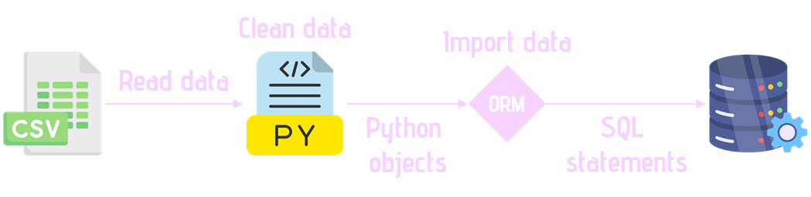
DATA CLEANING & IMPORTING
Notes:
Tried with cloud database but limited by storage and performance.

Slide 10
03
THE DATABASE

Slide 11
DATABASE ACCESS
Database is ideally hosted on a server and accessible to all in the company via the cloud.
For this project, we were limited by storage and performance. The solution was to share the Python code to import the data into our own MySQL servers. Since our data was handled beforehand, this still maintained consistency.
Notes:
Tried with cloud database but limited by storage and performance.

Slide 12
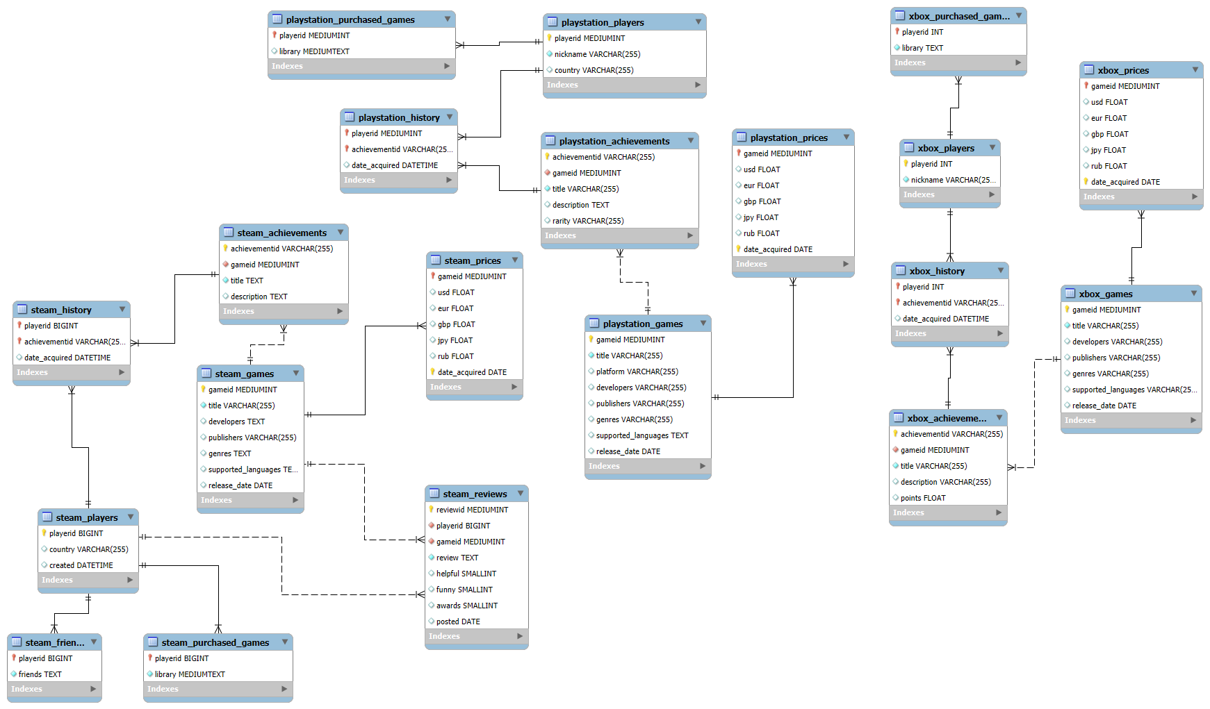


OUR DATABASE
Schema pic here
Primary key
Foreign key

Slide 13
DATA STORAGE
Since data is stored on individual machines, for this project, our recovery plan is to simply re-run the Python code to re-populate the SQL tables.
Files were also shared via Drive, which allowed multiple users to have access and provided an additional back-up point.
If using a Cloud database, our recovery plan would include using mysqldump to generate back-up files of the database periodically.

Slide 14
04
DATA ANALYSIS

Slide 15
DATA ANALYSIS
PowerBI was used to visually display and analyze our data.
Since we are focused on certain data, the information was extracted from each platform and combined into the following PowerBI schema.

Slide 16
DATA ANALYSIS
The main question we want to answer with this data is “What is the most commonly purchased game in general and on 3 different platforms?”
This question is not easily answerable as “times purchased” is not a category tracked for games.
Instead, we have access to players’ libraries. From that, we were able to extract purchase information.

Slide 17
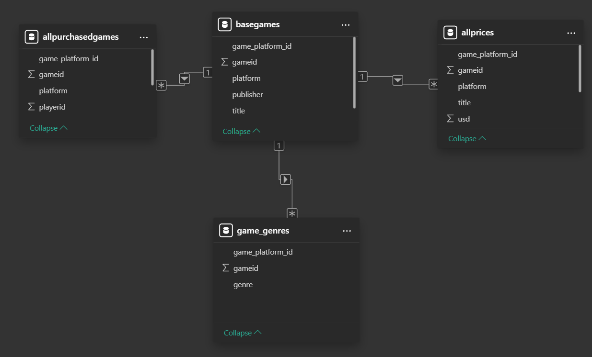
OUR DATABASE
Schema pic here

Slide 18
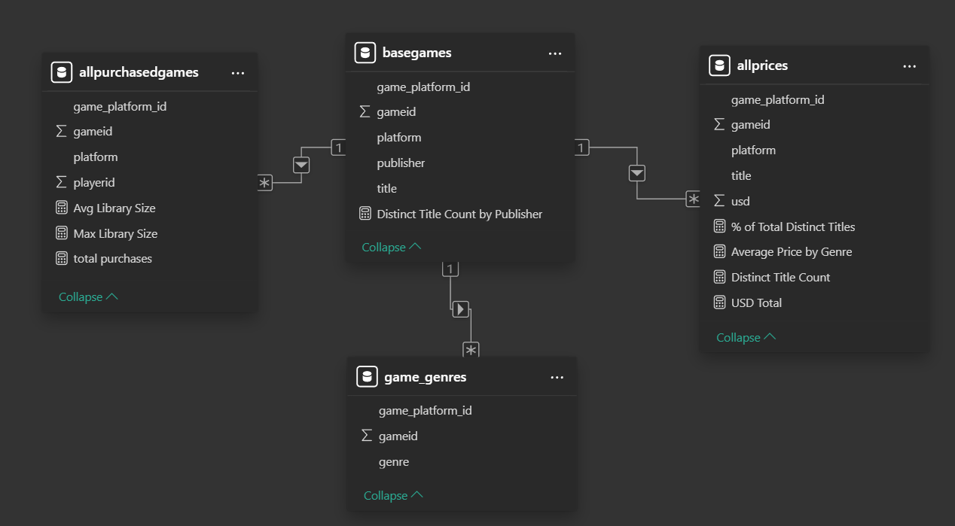
OUR DATABASE
Schema pic here

Slide 19
“What is the most commonly purchased game in general and on 3 different platforms?”

Slide 20
PowerBI Dashboard Link!

Slide 21
RELEVANCE OF THIS PROJECT
Analyzing game purchases by genre and platform helps us identify what types of games are popular and where.
This insight allows us to target ads more effectively for gaming companies, increasing ad relevance and engagement.
It also helps us recommend games to users based on trends, boosting user experience and community interaction on our platform.

Slide 22

THANKS!
Thinh Le
Github: letatthinh
Tara Jacobsen
Github: taramjacobsen
https://github.com/taramjacobsen/dssa5102finalproject
Notes:
https://github.com/taramjacobsen/dssa5102finalproject

